Slide 1
Physical computing from Scratch using scratchClient – Intermediate Control servos, LEDs and more from Scratch using RPi, Arduino, scratchClient
Hans de Jong & Gerhard Hepp
Pi And More 10 1/2
Stuttgart – 24 February 2017

Slide 2
Part 1: Adding analog input

Slide 3
Changing the wiring on the board
When changing the wiring on the board
First pull the USB cable out
Switch off the 9V supply

Slide 4
The electronics of a potentiometer
The potmeter is a resistor that will be connected between 5 V and 0 V.
Over the length of the resistor the voltage drops linearly.
E.g. in the middle it would be 2.5 Volt
So this is an analog signal. The value can be changed between 5 V and 0 V.
There is a 1 kOhm resistor in series for the reasons discussed earlier
+5 Volt
Consider what would happen if the 1 kOhm resistor were not there and the port would be used as output and potmeter positioned close to the 0 Volt side.
Then the Arduino would output 5 Volt, and the potmeter is directly leading it to the 0 Volt line → short circuit!
Arduino
1 kOhm
Potentiometer
Analog input
10 kOhm
Resistor
0 Volt

Slide 5
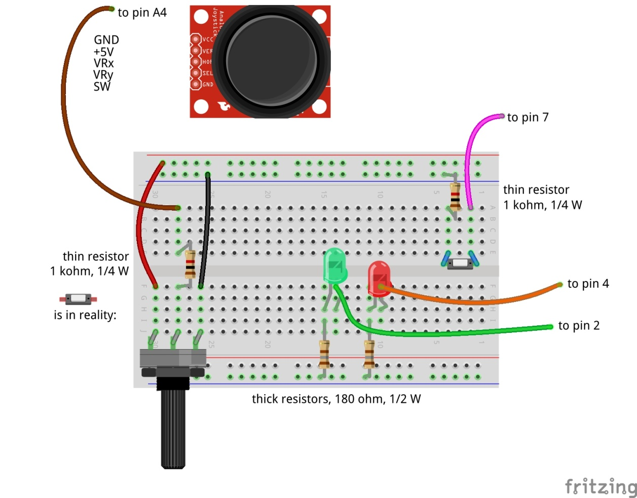
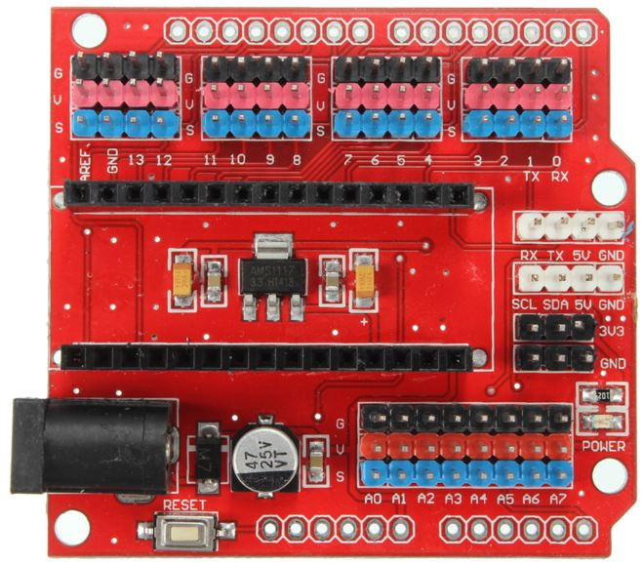

Adding analog input
Don’t forget: power off and USB cable out before making changes!

Slide 6
Update the config file
Update the config file again (right click PiAndMoreConfig.scl on the desktop, scratchConfig Edit)
Define Potmeter on pin A4 (direction: in, function: analog)
Now that you are updating anyway, already define for the next steps:
Define Servo1 on pin 12 (direction: out, function: servo)
Define BigBlueLED on pin 5 (direction: out, function: PWM)
Define Buzzer on pin 11 (direction: out, function: PWM)
Don’t forget to save. Keep the config editor open.

Slide 7
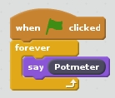
Test whether it works
Reconnect and repower the board
Stop and restart scratchClient by double clicking PiAndMoreConfig.scl on the desktop
Make this piece of program and run it
Turn the knob and see the values of Potmeter change
Between about 0 and about 1024
We will write some Scratch program to use it in the next step

Slide 8
Part 2: Pulse Width Modulation

Slide 9
Where we are …
We have seen:
Digital Input (the button) (in the beginners module)
Digital Output (the LEDs) (in the beginners module)
Analog Input (the potentiometer)
So what would be most logical next?
Analog Output? → but it does not exist!
However there is a good alternative: Pulse Width Modulation

Slide 10
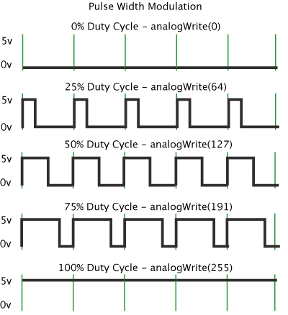
Pulse Width Modulation (PWM)
By modulating (changing) the pulse width, the amount of energy fed to e.g. the LED is changed, and hence the intensity with which you see it lighting.
Note that in practice the LED is blinking some 800 blinks / second.
However, no human eye can see more than 100 blinks / second.

Slide 11
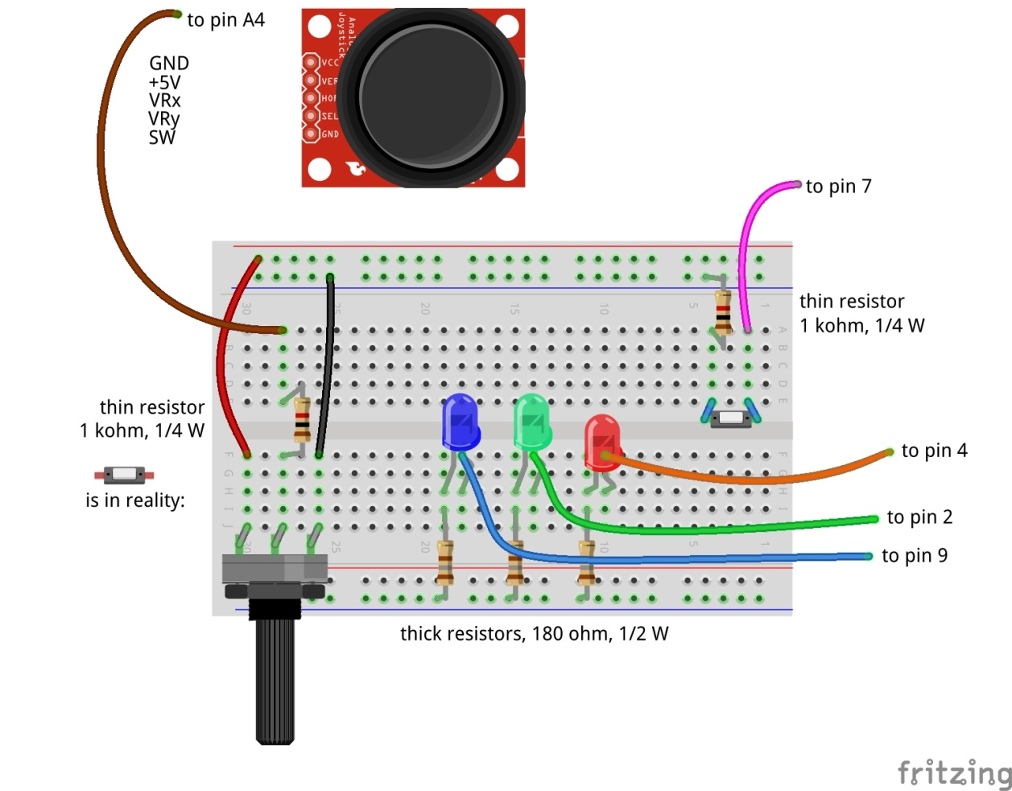
Dimming the BigBlueLED with PWM
to pin 5
Don’t forget: power off and USB cable out before making changes!

Slide 12
Test
Switch the power on again and reconnect
You will see that scratchClient finds the board again
You already updated the config file in the previous step, so no need to restart scratchClient
Send BigBlueLED values between 0 and 255
You can use the slider on the displayed variable for values between 0 and 100
For values above 100 we will use a program, see next slide
Does the LED brightness change?

Slide 13
Connect Potmeter and Big Blue LED (via Scratch)
Make some code that takes the potentiometer reading (between 0 and 1024) and transforms it into the range 0 to 255 (so divide by 4) and set the value of BigBlueLED.
Try out whether turning the potmeter changes the light intensity.
Notice that when turning to the right, the intensity goes down.
You would expect it to go up …
How can you very simply change this by interchanging two wires?

Slide 14
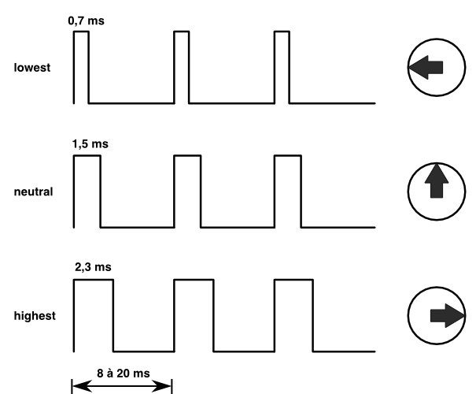
Controlling a servo with PWM
The position of the servo is changed by sending pulses of different width.
The servo looks at the pulsewidth and turns as desired.
The servo gets power separately.
With a servo, the pulse width modulation is not controlling the amount of energy fed to the servo
With a servo, pulse width modulation is rather a communication protocol.

Slide 15
Adding the servo to pin 12
to pin 5
Dark brown wire here
Don’t forget: power off and USB cable out before making changes!

Slide 16
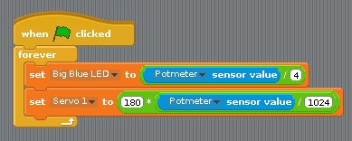
Testing the servo
Reconnect and repower the board
In Scratch, create a variable Servo1 and make it visible.
Try out giving it values between 0 and 100 via the slider on the variable.
The servo can handle values between 0 and 180
Does it move?
Update the loop where you set the Big Blue LED value dependent on the potmeter reading to now also set Servo 1.
But watch out: values have to be between 0 and 180.
To avoid overflow: first divide by 1024, then multiply by 180.
You may observe jitter.
Because the values of the potmeter will drift a bit and there will be power fluctuations, the reading of the potmeter will not be constant.
We will in the advanced workshop show how to deal with jitter

Slide 17
Controlling a buzzer with PWM
The buzzer will sound if it gets a signal in an audible frequency range.
A PWM signal on Arduino gives ca. 800 Hz.
Different for different pins
You will see that there is not much influence by changing the duty cycle.

Slide 18
Connect the buzzer to pin 11
Carefully watch the wires. Connect Vcc, GND and I/O correctly!
to pin 5
Don’t forget: power off and USB cable out before updating!

Slide 19
Testing the buzzer
No need to restart scratchClient, because the config file was not changed.
Define a variable Buzzer in Scratch
Give it values between 0 and 100
Using the slider on the variable
Does the value have much impact?
Add the setting of the buzzer to the loop where you already set the servo and the Big Blue LED.
Like with the LED, the values must be between 0 and 255.
Only test a short time (to save the ears of your neighbors ☺).

Slide 20
PWM limitations of Arduino (Nano and Uno)
General PWM is available on pins 3, 5, 6, 9, 10, 11
Servo can be configured on those pins, but also on 2, 4, 7, 8, 12
If a servo is configured on any pin, pins 9 and 10 cannot be configured as PWM anymore.
The config tool will warn you if you do it wrongly.

Slide 21
Part 9: Make a Scratch program
Extra material in case you have time left

Slide 22
Integrate with sprites
Load the following sprite
Big Red LED
Sits in the PiAndMore folder on the desktop in a folder Sprites.
Take a look at the code of the sprite.
Update the code that you wrote earlier today for the BigRedLED so that it sends messages to the sprite to turn the LED on and off

Slide 23
Add the Big Green LED sprite
Same that you did with the Big Red LED sprite, but now for the Big Green LED sprite.

Slide 24
Add the Big Blue LED sprite
Load the Big Blue LED sprite
Analyse the code in that sprite, which is different
The Big Blue LED sprite will move over the screen as the intensity changes
You can also move it with your mouse and see the intensity change.
Update your code that you wrote earlier to make use of the sprite.

Slide 25
Part 10: Take your work home

Slide 26
Do you want to take your work home?
If you brought your own USB stick, then connect it and copy the PiAndMore folder on the desktop
The rest of the material you can download from www.github.com
Take the flyer with you to remember where to find the material on github.

Slide 27
Part 11: Summary & take aways

Slide 28
Take aways of the beginners workshop
With scratchClient you define:
Function of each pin
Symbolic name for each configured pin
scratchClient config is the tool to setup the configuration
Restart scratchClient after you changed the configuration
Put a resistor in series with LEDs
Put a resistor in series with switches
Put a resistor in series with the middle contact of a potentiometer.
Configure a pull up resistor if the input signal goes between 0 Volt and being open rather than between 0 Volt and 3 to 5 Volt.
Output signals are controlled from Scratch by giving a variable a value
Input signals are monitored by the sensor programming elements
You can monitor the value of all pins from the browser
scratchClient can do much more…
Functions that a pin on Arduino can have:
Digital In
Digital Out
Analog In
No Analog Out
Pulse Width Modulation as alternative
For modulating the brightness of a LED
For controlling a servo
For controlling a buzzer
There a few more, see the advanced workshop
You can configure pull up resistors on Digital In

Slide 29
End of the intermediate workshop

Slide 30
If you want to know more …
Join the advanced workshop
Download the material and read the extensive documentation

Slide 31
Part 12: Clean up / teardown

Slide 32
If you continue to the Advanced Workshop …
You can continue to use your setup, with one exception:
You need to move the Big Blue LED to pin 9
Direction: out, function: output (so no PWM)
In the mean time you should know how to do this, otherwise please ask.

Slide 33
If your scratchClient day ends here …
Unplug the board from USB and power off the device
Please remove all components and wires from the breadboard
Remove all wires from the Arduino board.
Leave the wires on the 3 color LED (you did not use that)
Leave the wires on the buzzer
If something is broken, please
Throw it away or hand it in (if it is unclear)
Put a note in the box that it is missing
Do not put anything that is broken back in the box
Leave the Arduino running
Let us know what you thought about this workshop, now orally or later by email
hans.piam@hanselma.nl
heppg@web.de

Slide 34
More information
All workshop material
www.github.com and search for Weekendschool or for PiAndMore
scratchClient
http://heppg.de/ikg/wordpress/?page_id=6
Scratch
https://scratch.mit.edu/
Scratch on Raspberry Pi
https://www.raspberrypi.org/forums/viewforum.php?f=77
Raspberry Pi
https://www.raspberrypi.org/
Arduino
https://www.arduino.cc/

Slide 35
The End

